Slide 1

Sauce & Spoon
Tablet Rollout
Impact Report

Slide 2
Executive Summary
The goal is to launch a pilot project to roll out tablet menu at two of its locations: Sauce and Spoon North and Sauce and Spoon Downtown.The tablets will be deployed in the bar sections of both restaurants, allowing guests to place their orders and pay directly without waiting for servers. This initiative aims to improve customer experience by reducing table turn times, increasing upselling opportunities, and addressing operational challenges such as food waste and staff efficiency.
The tablet rollout was first pilot tested with friends and families and based on the feedback from the test, it was further improved and launched in April,2023. The major accomplished of the launched has listed as below:
Tablets decreased table wait time by 30% with an increase of average guest count by 10%
Food waste was decreased by 50%.
Average Checkout time was one minute or less.
Customer satisfaction was improved to 86% than compared to initial pilot test of 72%.
Monthly revenue was increased by 20% since September/pre-rollout
Both GMs of two location did not focus on the company goal of improving customer satisfaction which resulted in no changes in table turn time. Later, they realized , they need to give focus of company goal instead of their own location goals. Next, waitstaff and kitchen staff did not have good collaboration between them which led to no changes in table turn time and waste of foods. Later, detailed training help sort out this issue.
Now, after success of this project , our next goals are as follows:
Implement tablets in other locations of Sauce and Spoon. by Q2
Continue to track customer feedback and make improvements
Exapland tablet features (like social media integraiion, reservations, video etc by Q4

Slide 3
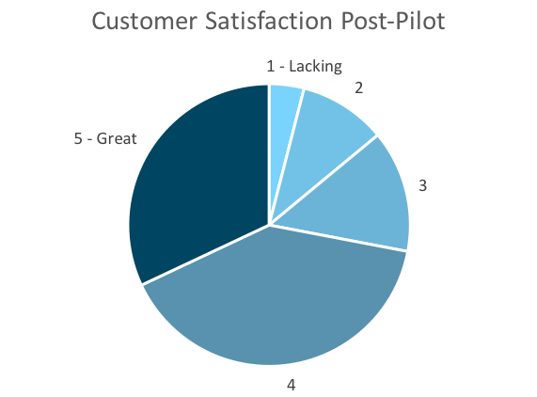
Customer Satisfaction: Pilot
Q. On a scale of 1-5, please rate your experience with the tablet overall.
This pie chart illustrates the results from the post-pilot survey.
72% of respondents indicated a customer satisfaction score of 4 or 5.
Notes:
First pie chart: Results from the post-pilot survey
Second pie chart: Results from the post-launch survey, after making changes
Satisfaction has gone up from 72% (4 and 5 rating) to 86% (4 and 5 rating)
Post-pilot data:
1 - Lacking 2 4%
2 5 10%
3 7 14%
4 20 40%
5 - Great 16 32%
Post-launch data:
1 - Lacking 1 2%
2 2 4%
3 4 8%
4 22 44%
5 - Great 21 42%

Slide 4
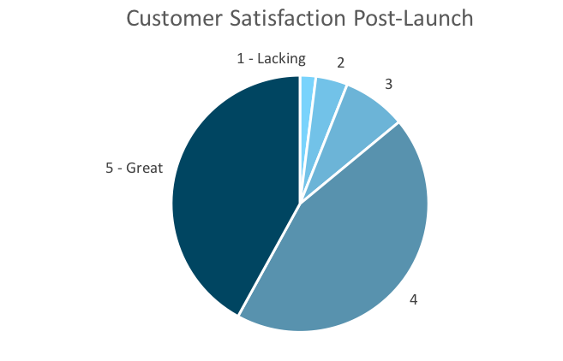
Customer Satisfaction: Launch
Q. On a scale of 1-5, please rate your experience with the tablet overall.
This pie chart illustrates the results from the post-launch survey.
86% of respondents indicated a customer satisfaction score of 4 or 5. This is a 14% increase.
Notes:
First pie chart: Results from the post-pilot survey
Second pie chart: Results from the post-launch survey, after making changes
Satisfaction has gone up from 72% (4 and 5 rating) to 86% (4 and 5 rating)
Post-pilot data:
1 - Lacking 2 4%
2 5 10%
3 7 14%
4 20 40%
5 - Great 16 32%
Post-launch data:
1 - Lacking 1 2%
2 2 4%
3 4 8%
4 22 44%
5 - Great 21 42%

Slide 5
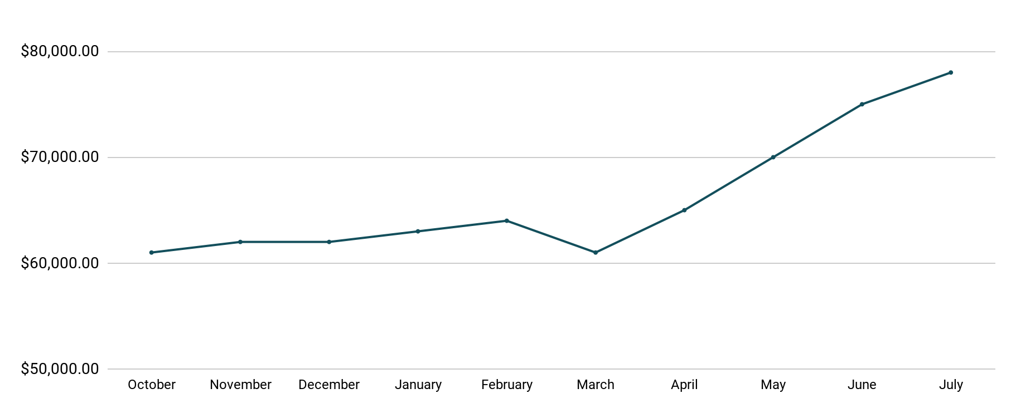
Revenue
Tablet Launch April 23
This is a chart of Sauce & Spoon revenue, showing that after tablet implementation, revenue increased.
July revenue was up to 20% over April’s monthly revenue.
Notes:
This is a chart of Sauce & Spoon revenue, showing that after tablet implementation, revenue increased. December revenue was up to 20% over September’s monthly revenue.
Sales data:
October
$61,000.00
November
$62,000.00
December
$62,000.00
January
$63,000.00
February
$64,000.00
March
$61,000.00
April
$65,000.00
May
$70,000.00
June
$75,000.00
July
$78,000.00

Slide 6
What Worked: Key Accomplishments
Decreased table turn time
Implementation of the tablets increased the average daily guest count by 10%.
Tablets also decreased wait time by 30 minutes.
Decreased food waste
Tablets identified who was receiving an incorrect order.
Kitchen staff has taken the initiative to correct orders and decrease food waste by 50%.
Increased customer satisfaction
After the pilot, customer satisfaction was at 72%.
Once we implemented improvements based on feedback, customer satisfaction increased to 86%.
Increased sales
Our monthly revenue has increased steadily since the tablet rollout, upwards of 20% since September/pre-rollout.
Tablets also helped boost revenue during the holiday season.

Slide 7
Next Steps: Looking Forward
Initiative | Action | Date
Implement tablets in more locations | Create new project plan for new location installation | Q2
Continue to track customer experience and satisfaction | Continue surveying/ gathering data through various means | Ongoing
Expand tablet features | Investigate new features like social media integration, reservations, videos, etc. | Q4

Slide 8
Appendix
Access all resources here.
Notes:
Insert link to your shared drive or a shared folder with all of the relevant project artifacts

